Slide 1
Java Lecture 13

Slide 2
File class
This class comes from java.io. Package
This class is used to work on the attributes /characteristics of file not on data.
In java even directories are treated as files.
Constructors
  File(String pathwithname)
  File(String Parent,String name)
  File(File parent,String name)
  Eg:
    File f0=new File(“C:\\Data\\First.txt”);
    File f1=new File(“C:/Dat/First.txt”);
    File f2=new File(“C:\\Data”,”First.txt”);
    File f3=new File(“C:\\Data”);
    File f4=new File(f3.”First.txt”);

Slide 3
File class
Methods:-
  String getName()
  String getParent()
  String getPath()
  long lastModified()
  boolean canRead()
  boolean canWrite()
  boolean isHidden()
  boolean exits()
  boolean isFile()
  boolean is Directory()

Slide 4
Streams
These are the pipelines that are used for the purpose of reading and writing of data.
They can be classified as
  Byte Streams // bytes
  Character Streams //unicode
InputStream and OutputStream are class related Byte Stream.
Reader and Writer are class related to Character Stream .
Reader/Input Streams are used to read the data from keyboard ,file or socket to primary memory
Writer / Output Streams are used to write the data to monitor, file or socket from primary memory

Slide 5
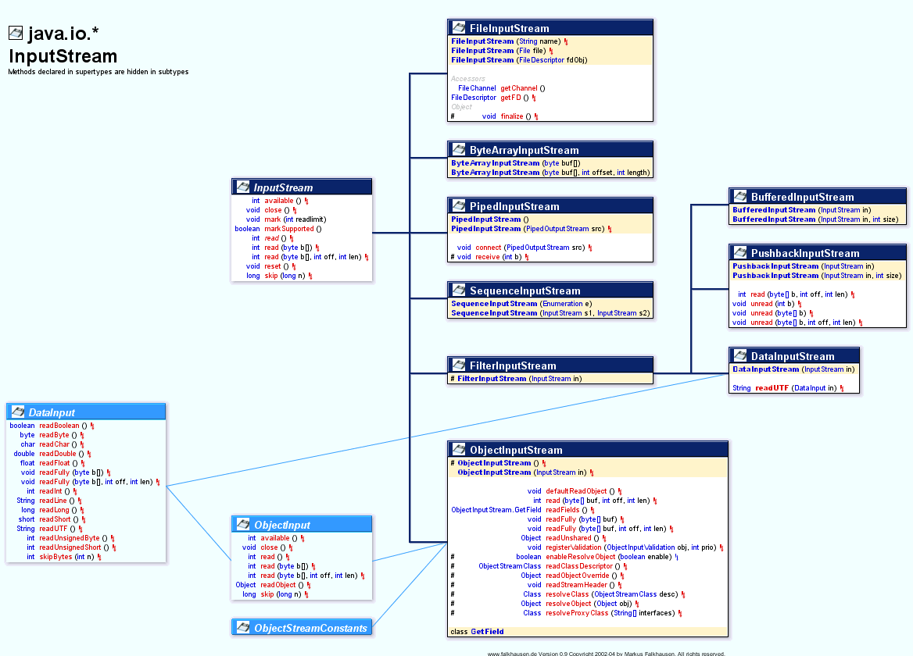


Slide 6
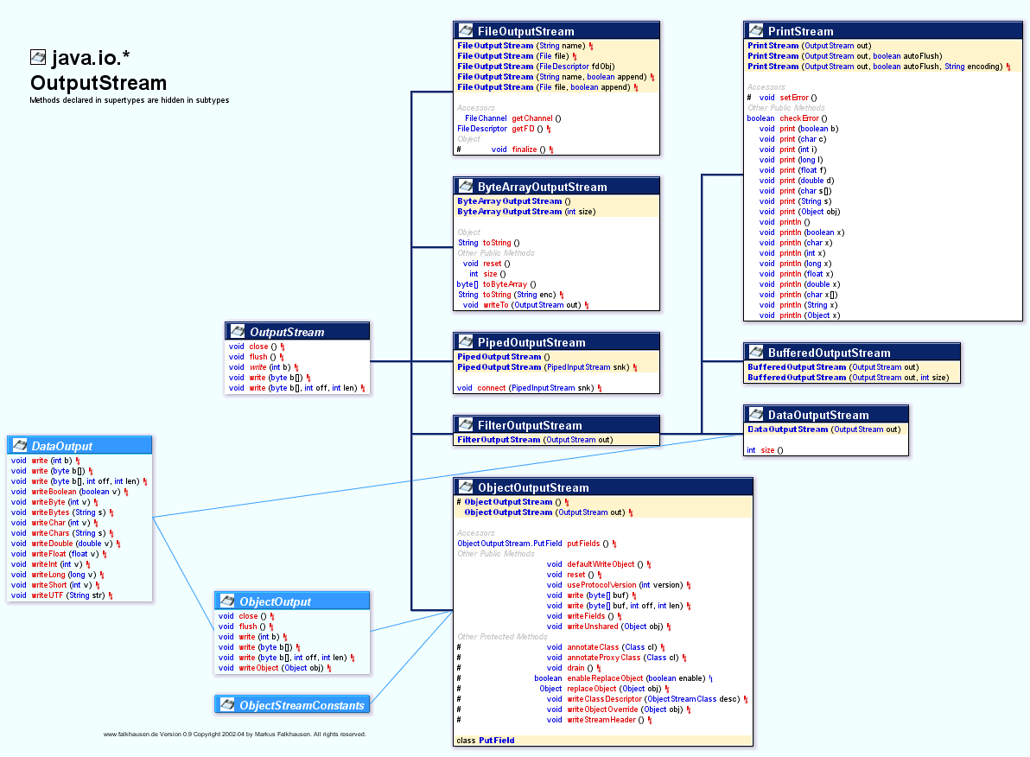
Streams

Slide 7
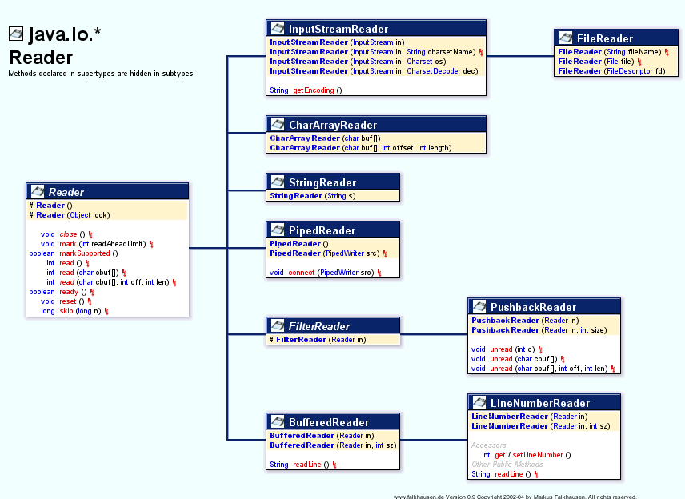

Slide 8
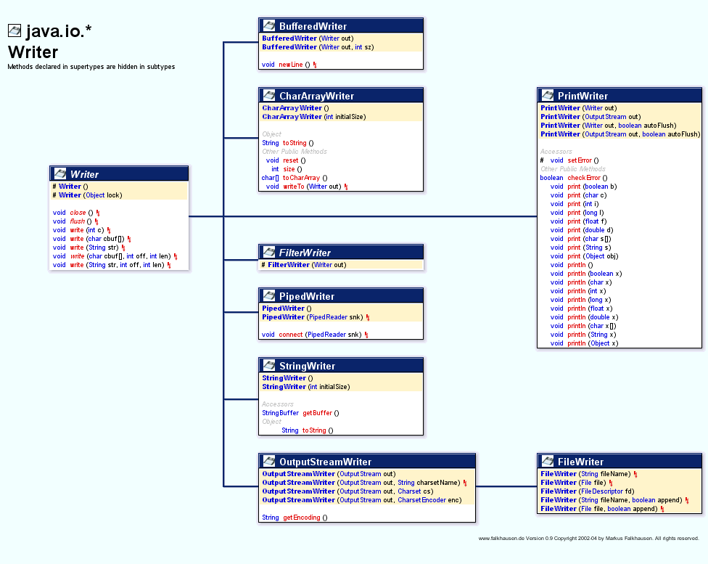

Slide 9
Multithreading
Thread:
  Smallest unit of execution.
  It helps to share time from processor
  By default ever application have single thread called “main” thread.
  When a thread has finished its job, it is suspended or destroyed.
  Using multithreading we can perform more than one task simultaneously
  Optimum utilization of Resources
  Difference between multithreading and multitasking

Slide 10
Multithreading
Thread:
  Threading is the ability to have multiple “simultaneous” lines of execution running in a single program.
  Aside from Java, the language Ada—used by the Department of Defense—is the only other language that natively supports multi-threading.
  Because they are sharing the cycles of the one CPU, each thread is given a priority—which is a number from 1-10. ( 5 is the default priority.)
  Threads with a higher priority number are given more turns at the CPU.
  In fact, depending on the operating system, a thread’s priority can have a more drastic impact.

Slide 11
Multithreading
Thread class
  When we wish to make a Java program use threading, the easiest way is to say our class extends the class Thread.
  Class Thread has different constructors & methods
    Thread()
    Thread( String name )
    run()
    start()
  Normally, you will never call the run() method yourself. You will call another method— start() —and the JVM will call run() when it is good and ready.

Slide 12
public class MyThread extends Thread
{
}
As you would expect, we begin by extending the class Thread.

Slide 13
public class MyThread extends Thread
{
public MyThread( String n )
{
super( n );
System.out.println( “MyThread Constructor” );
}
}
public void run()
{
System.out.println( “In run!\n” );
}
First, add the constructor method—which names the thread “Thread-x”.
Now, because it sub-classes Thread, class MyThread is an instance of the thread class.
Class Thread contains a method run() that is empty—it does nothing.
So, if you want anything to happen in your thread, you need to override the method run().

Slide 14
public class MyThread extends Thread
{
public MyThread( String n )
{
super( n );
System.out.println( “MyThread Constructor” );
}
public void run()
{
System.out.println( “In run!\n” );
}
public class TestMyThread
{
public static void main( String[] args )
{
}
}
Next we build a driver program and put in a method main. When main executes, the JVM places it in a
single thread context.

Slide 15
public class MyThread extends Thread
{
public MyThread( String n )
{
super( n );
System.out.println( “MyThread Constructor” );
}
public void run()
{
System.out.println( “In run!\n” );
}
public class TestMyThread
{
public static void main( String[] args )
{
}
}
So, will we already be running a thread in main now?
MyThread chuck = new MyThread( "Charlie" );
chuck.start();
MyThread dede = new MyThread( ”Deirdra" );
dede.start();
MyThread pat = new MyThread( “Patrick" );
pat.start();
main() will instantiate and start() all these threads. After they have started, the methods immediately return and the thread main() dies. However the entire application doesn’t die until the last thread does.

Slide 16
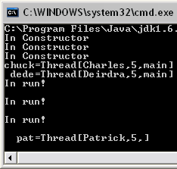
public class MyThread extends Thread
{
public MyThread( String n )
{
super( n );
System.out.println( “In Constructor” );
}
public void run()
{
System.out.println( “In run!\n“ );
}
}
public class TestMyThread
{
public static void main( String[] args )
{
MyThread chuck = new MyThread( “Charles” );
chuck.start();
MyThread dede = new MyThread( “Deirdra” );
dede.start();
MyThread pat = new MyThread( “Patrick” );
pat.start();
System.out.println( "chuck=" + chuck.toString() );
System.out.println( " dede=" + dede.toString() );
System.out.println( " pat=" + pat.toString() );
}
}

Slide 17
Thread Methods
static void sleep( long millisecs )
—Causes the currently executing thread to sleep (meaning temporarily cease execution) for the specified number of milliseconds.
—During this sleep time the thread does not use any resources of the processor.
static void yield()
—Causes the currently executing thread object to temporarily pause and allow other threads of equal priority to execute.
—You would use the method yield() only if your operating system did not support preemptive multithreading.

Slide 18
Thread Methods
static Thread currentThread()
—Returns a reference to the currently executing thread object.
—In other words, if you want to know which thread is currently executing, you execute this method…. and what would be the syntax to do that?
Thread x;
x = Thread.currentThread();

Slide 19
Thread Methods
void wait()
—The thread itself calls the wait() method to
wait for a specific condition to be satisfied.
boolean isAlive()
—returns true if:
• start() has been called for the thread, and
• the thread is not yet dead, meaning
• the run() method has not yet finished and
died.

Slide 20
Thread Methods
final void setPriority( int p )
—This method allows you the change the priority to an integer between 1 and 10.
final int getPriority()
—This method lets you return the priority for a thread.
—Notice, this method is final to prevent you from causing any mischief.

Slide 21
Life Cycle of a Thread
Thread is Instantiated
• born
When start() method is called, thread enters ready state.
•
• ready
Highest priority thread that is ready enters running state
System assigns a processor to the thread and the thread begins to execute its run() method.
• running
•
When run() method completes or terminates, thread enters dead state.
• dead
Thread marked to be removed from the system.
Entered when run() terminates or throws uncaught exception.

Slide 22
Working Cycle of a Thread
• blocked
• sleeping
• waiting

Slide 23
Working Cycle of a Thread
To enter blocked state, thread must already have been in running state.
• blocked
Even if the CPU is available, a
blocked thread cannot use the processor.
Common reason for a thread being in a blocked state—waiting on a request for file I/O .

Slide 24
Working Cycle of a Thread
Entered when sleep() method has been called for a thread.
• sleeping
While in the sleep state, a thread cannot use the processor.
After its sleep time expires, the thread re-enters the ready state.
It doesn’t starting running again, it becomes eligible to run—much in the same way it did when you called the start() method.

Slide 25
Working Cycle of a Thread
Entered when wait() method has been called in an object thread is accessing.
• waiting
One waiting thread becomes ready when object calls the method notify().
When the method notifyAll() has been called—all waiting threads become ready.

Slide 26
Life Cycle of a Thread
• A thread executes until:
—it dies,
—it calls sleep(),
—it calls wait(),
—it calls yield(),
—its quantum of time is used up, or
—it is preempted by a higher priority thread.

Slide 27
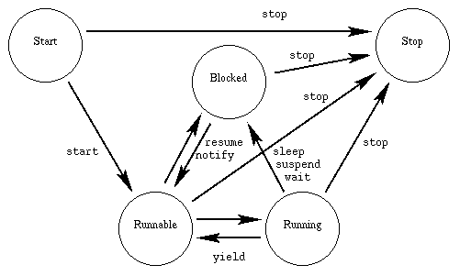
Life –Cycle of thread

